Slide 1
Inheritance

Slide 2
Inheritance
Inheritance in Java is a mechanism in which one object acquires all the properties and behaviors of a parent object. It is an important part of OOPs(Object Oriented programming system).
The idea behind inheritance in Java is that you can create new classes that are built upon existing classes. When you inherit from an existing class, you can reuse methods and fields of the parent class. Moreover, you can add new methods and fields in your current class also.
Inheritance represents the IS-A relationship which is also known as a parent-child relationship.

Slide 3
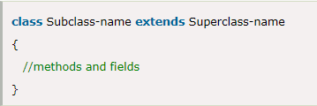
Why use inheritance in java?
For Method Overriding (so runtime polymorphism can be achieved).
For Code Reusability.
The syntax of Java Inheritance
The extends keyword indicates that you are making a new class that derives from an existing class. The meaning of "extends" is to increase the functionality.
In the terminology of Java, a class which is inherited is called a parent or superclass, and the new class is called child or subclass.

Slide 4
Single Inheritance
When a subclass is derived simply from its parent’s class then this mechanism is known as single inheritance.
In this type there is only one child class and one parent class.
class Employee
{
float salary=40000;
}
class Main extends Employee
{
float bonus=10000,total;
public static void main(String args[])
{
Main p=new Main();
System.out.println("Programmer salary is:"+p.salary);
System.out.println("Bonus of Programmer is:"+p.bonus);
p.total=p.salary + p.bonus;
System.out.println(“Total Salary of Programmer is:"+p.total);
}
}
Output:
Programmer salary is:40000.0
Bonus of Programmer is:10000.0
Total Salary of Programmer is:50000.0

Slide 5
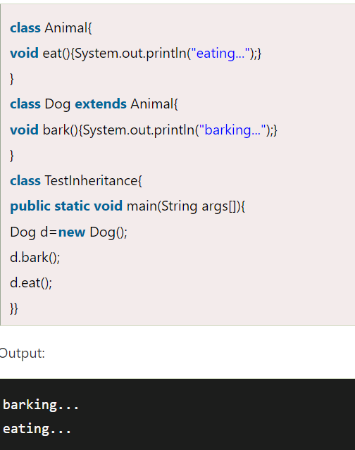

Slide 6
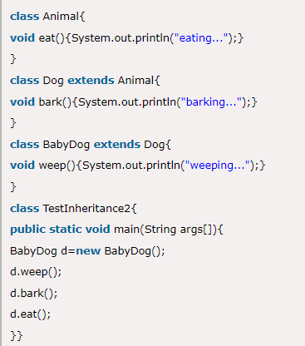
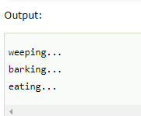
Multilevel Inheritance
When there is a chain of inheritance, it is known as multilevel inheritance. As you can see in the example given below, BabyDog class inherits the Dog class which again inherits the Animal class, so there is a multilevel inheritance.

Slide 7
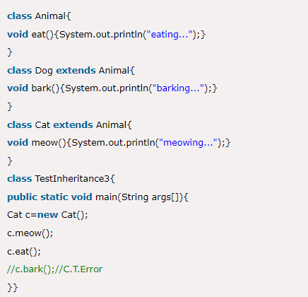
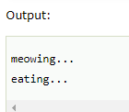
Hierarchical Inheritance
When two or more classes inherits a single class, it is known as hierarchical inheritance. In the example given below, Dog and Cat classes inherits the Animal class, so there is hierarchical inheritance.

Slide 8
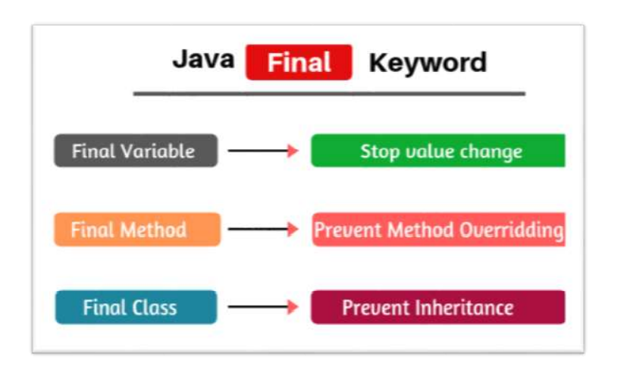

Slide 9
Final Keyword
Final variable: The value of a final variable cannot be changed.
Example of declaring final variable: final int SIZE = 150;
When a variable is declared with final keyword, its value can’t be modified, essentially, a constant. This also means that you must initialize a final variable.
It is good practice to represent final variables in all uppercase, using underscore to separate words.
final method: making a method final ensures that the functionality defined in this method will never be altered in any way, i.e. a final method cannot be overridden.
Syntax: final void findAverage()
{
//implementation
}

Slide 10
class OuterClass {
private static String msg = "GeeksForGeeks";
public static class NestedStaticClass {
public void printMessage() {
System.out.println( "Message from nested static class: " + msg);
}
}
public class InnerClass {
public void display(){
System.out.println("Message from non-static nested class: "+ msg);
}
}
}
class GFG {
public static void main(String args[]) {
OuterClass.NestedStaticClass printer = new OuterClass.NestedStaticClass();
printer.printMessage();
OuterClass outer = new OuterClass();
OuterClass.InnerClass inner= outer.new InnerClass();
inner.display();
OuterClass.InnerClass innerObject = new OuterClass().new InnerClass();
innerObject.display();
}
}

Slide 11
Abstract class, method
A class which is declared with the abstract keyword is known as an abstract class in Java. It can have abstract and non-abstract methods (method with the body). It needs to be extended and its method implemented. It cannot be instantiated.
A method must always be declared in an abstract class. A method is declared with abstract keyword
Abstract method is present without body (no implementation).
Child class needs to override definition of all abstract method
Syntax :
abstract type method-name();
public abstract int myMethod();

Slide 12
abstract class Bike
{
abstract void run();
}
class Honda4 extends Bike
{
void run()
{
System.out.println("running safely");
}
public static void main(String args[])
{
Bike obj = new Honda4();
obj.run();
}
}

Slide 13
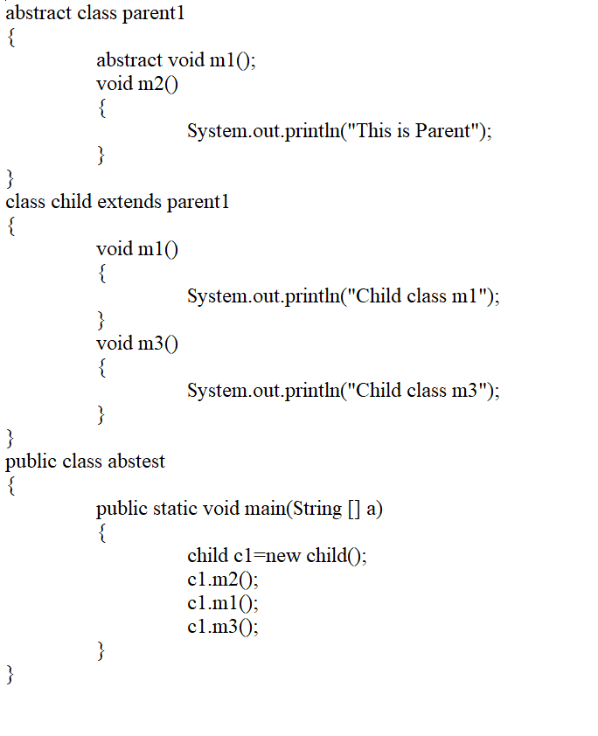

Slide 14
Interface in Java

Slide 15
Interface
The interface in Java is a mechanism to achieve abstraction. There can be only abstract methods in the Java interface, not method body. It is used to achieve abstraction and multiple inheritance in Java.
An interface is collection of abstract method and it is defined much like class.
Writing an interface is similar to the class, with abstract methods and final field.
This means that interface do not specify any code to implement those methods & data fields containing only constants.
Interfaces cannot be instantiated they can be only implemented by the classes or extended by other Interfaces. Interfaces are design to support dynamic method resolution at runtime.
Why use Java interface?
It is used to achieve abstraction.
By interface, we can support the functionality of multiple inheritance.

Slide 16
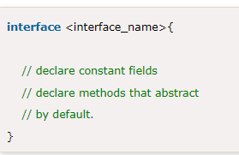
How to declare an interface?
An interface is declared by using the interface keyword. It provides total abstraction; means all the methods in an interface are declared with the empty body, and all the fields are public, final by default. A class that implements an interface must implement all the methods declared in the interface.

Slide 17
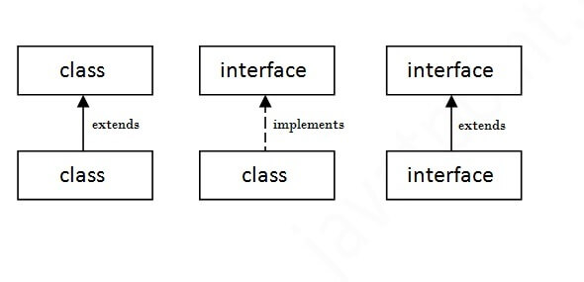
The relationship between classes and interfaces

Slide 18
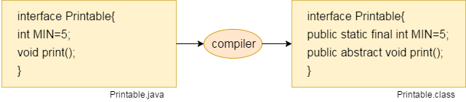

Slide 19
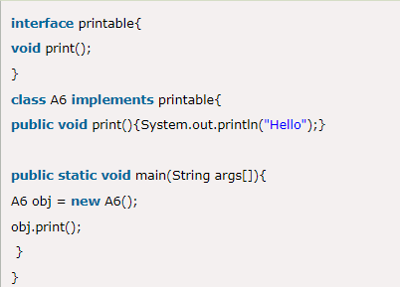

Java Interface Example

Slide 20
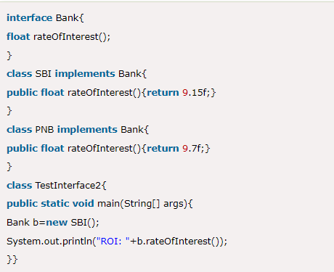

Java Interface Example: Bank

Slide 21
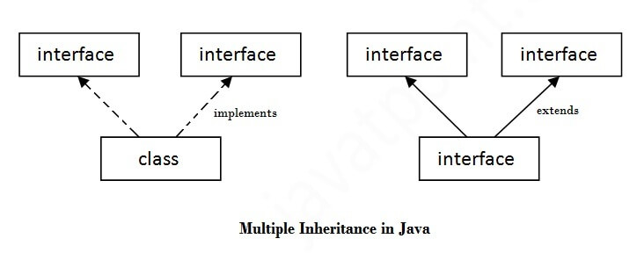
Multiple inheritance in Java by interface

Slide 22
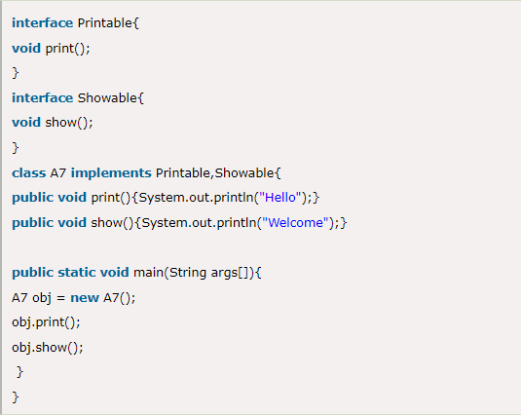

Multiple inheritance in Java by interface

Slide 23
Java static variable
If you declare any variable as static, it is known as a static variable.
The static variable can be used to refer to the common property of all objects (which is not unique for each object), for example, the company name of employees, college name of students, etc.

Slide 24
class Student{
int rollno;//instance variable
String name;
static String college =“WCE";//static variable
Student(int r, String n){
rollno = r;
name = n;
}
//method to display the values
void display (){
System.out.println(rollno+" "+name+" "+college);}
}
public class TestStaticVariable1{
public static void main(String args[]){
Student s1 = new Student(111,“ABC");
Student s2 = new Student(222,“XYZ");
//Student.college=“WCE Sangli";
s1.display();
s2.display();
}
}

Slide 25
Static method
If you apply static keyword with any method, it is known as static method.
A static method belongs to the class rather than the object of a class.
A static method can be invoked without the need for creating an instance of a class.
A static method can access static data member and can change the value of it.

Slide 26
class Student{
int rollno;
String name;
static String college = “WCE";
//static method to change the value of static variable
static void change(){
college = “WCE Sangli";
}
Student(int r, String n){
rollno = r;
name = n;
}
void display(){System.out.println(rollno+" "+name+" "+college);}
}
public class TestStaticMethod{
public static void main(String args[]){
Student.change();//calling change method
Student s1 = new Student(111,“ABC");
Student s2 = new Student(222,“XYZ");
s1.display();
s2.display();
}
}

Slide 27
Java static block
Is used to initialize the static data member.
It is executed before the main method at the time of classloading.
class A2{
static{
System.out.println("static block is invoked");
}
public static void main(String args[]){
System.out.println("Hello main");
}
}

Slide 28
Access Specifiers
Java provides a number of access modifiers to set access levels for classes, variables , methods and constructors.
The access specifiers available in Java are
Public
Private
Protected
Friendly

Slide 29
Public:
Public modifier achieves the highest level of accessibility.
A class, method, constructor, interface, etc. declared public can be accessed from any other class. Therefore, fields, methods, blocks declared inside a public class can be accessed from any class belonging to the Java Universe.
Private:
Private fields enjoy the highest degree of protection.
Methods, variables, and constructors that are declared private can only be accessed within the declared class itself. They are accessible only with their own class.
They cannot be inherited by sub classes and therefore not accessible in sub classes.
Friendly:
When no access modifier is specified, the member defaults to a limited version of public accessibility known as “friendly” level of access.
The difference between the public access and friendly access is that the public modifier makes fields visible in all classes, regardless of their packages while the friendly access makes fields visible only in the same package, but not in other packages.
Protected:
The visibility level of a “protected” field lies in between the public access and friendly access. That is the protected modifier makes the fields visible not only to all classes and sub classes in the same package but also to sub classes in other packages.
Note that non sub classes in other packages cannot access the “protected” members.

Slide 30
Private protected access
The visibility level lies between private and protected access.
This modifier makes fields visible in all subclasses regardless of what package they are in.
These fields are not accessible by other classes in the same package.
Modifier | Same class | Subclass In Same package | Other classes In same package | Sub class In other package | Non sub class In other package
public | Yes | Yes | Yes | Yes | Yes
protected | Yes | Yes | Yes | Yes | No
friendly (default) | Yes | Yes | Yes | No | No
private | Yes | No | No | No | No

Slide 31
The String class is commonly used for holding and manipulating strings of text in Java programs.
In java strings are class objects and implemented using classes namely, String, StringBuffer and StringBuilder.
In Java Programming language, strings are treated as objects.
The Java platform provides the string class to create and manipulate strings.
once a String object is created it cannot be altered. For mutable String, you can use StringBuffer and StringBuilder classes.

Slide 32
There are two ways two create String Object:
1)By String literals:
Example:
String s=“welcome”;
2)By new keyword:
Example:
String s=new String(“Welcome”);

Slide 33
public class Stringexample
{
public static void main(string args[]) {
String s1=“java”;
char ch={‘s’,’t’,’r’,’i’,’h’,’g’,’s’};
String s2=new String(ch);
String s3=new String(“example”);
System.out.println(s1);
System.out.println(s2);
System.out.println(s3);
}
}

Slide 34
String methods
length - str.length();
indexOf – indexOf(str);
charAt – str.charAt(index);
replace – str.replace(old_string,new_string);
toLowerCase – str.toLowerCase();
toUpperCase – str.toUpperCase();
compareTo – str.compareTo(str);
and many more like constains(),split(),startsWith(),endsWith(),trim(),
equals(),subString()…etc

Slide 35
String concatenation:
public class stringexample
{
public static void main(String args[])
{
String s = “Hello”;
String str = “World”;
String str1 = s.concat(str);
String str2 = “Hello”.concat(“World”);
String str3 = s + str;
String str4 = “Hello” + ”World”;
System.out.println(str1);
System.out.println(str2);
System.out.println(str3);
System.out.println(str4);
}
}

Slide 36
class stringexample
{
String s = “Hell”;
String s1 = “Hello”;
String s2 = “Hello”;
String s3 = “Java”;
System.out.println(s1.equals(s2)); //true
System.out.println(s.equals(s1)); //false
String s4 = new String(“Java”) ;
System.out.println(s1==s2); //true
System.out.println(s3==s4); //false
System.out.println(s.compareTo(s2)); //returns-1 because ss
System.out.println(s1.compqre To(s2)); //returns 0
System.out.println(s2.compareTo(s)); //returns 1
}
}

Slide 37
Example:
public class StringExample
{
public static void main(String args[])
{ String s = “Hello World”;
System.out.println(s.substring(6));
System.out.println(s.substring(0,5));
}
}

Slide 38
public class lengthexample{
public static void main(String args[])
{
String s1 = "Hello World";
System.out.println("String length is:"+s1.length());
}
}

Slide 39
StringBuffer methods
1. append(string) – str.append(“java”);
2. insert(index,string) – str.insert(2,”HI”);
3. delete(start_index,end_index) – str.delete(2,4);
4. reverse () – str.reverse();
5. replace(start_index,end_index,string)
-str.replace(0 ,2 , “HI”);
6. length() – str.length();
7. subString(index) – str.subString(3);
8. indexOf(string) – str.indexOf(“text”) ;
9. charAt(index) – str. charAt(4);
10. subSequence(start_index,end_index)
- str.subSequence(2, 5);
and many more…..

Slide 40
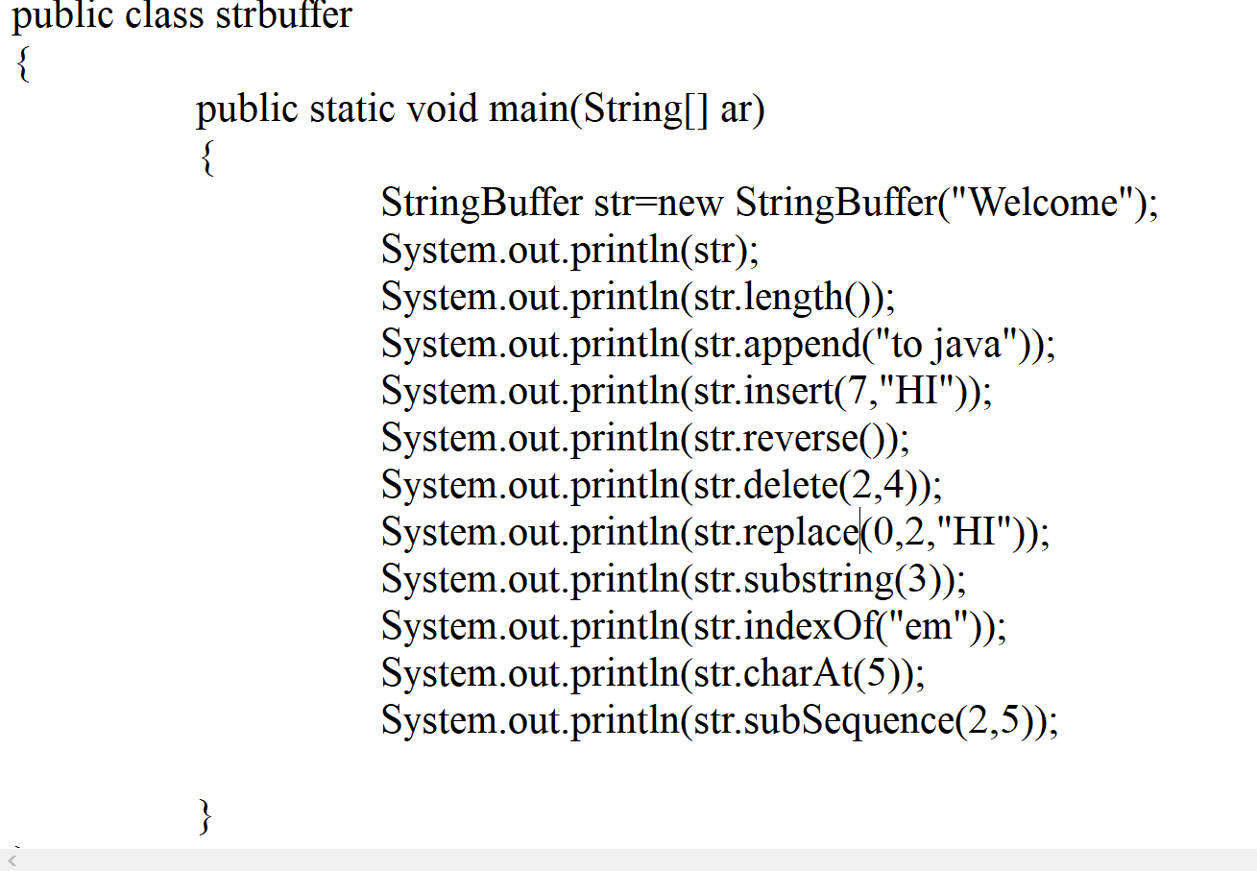

Slide 41
Package in Java

Slide 42
Package is nothing more than the way we organize files into different directories according to their functionality, usability as well as category they should belongs to.
Packaging also helps us to avoid class name collision when we use the same class name as that of others. Packages act as containers for classes.
Syntax:- package pakage_name;
For e.g.
package A;
class ABC
{
___________
___________
___________
___________
}

Slide 43
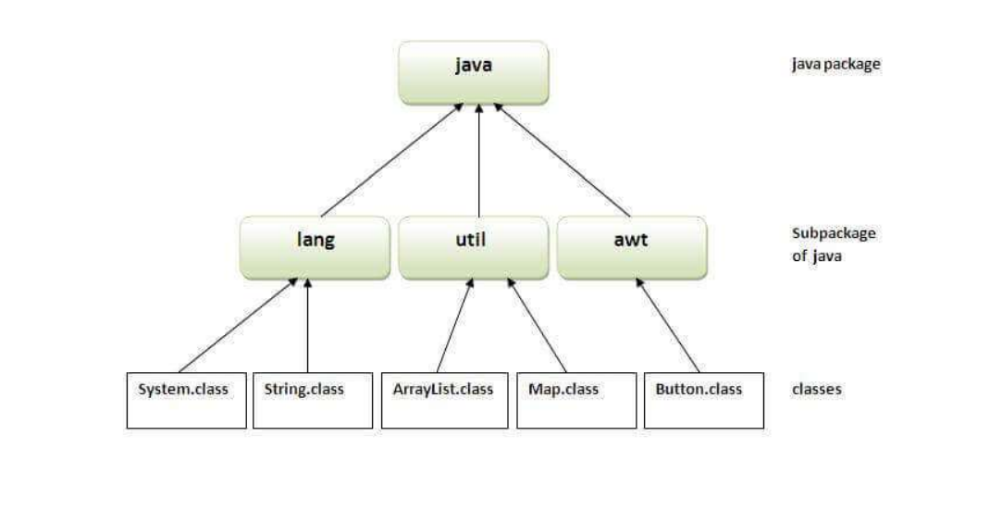
Advantages:
Java package is used to categorize the classes and interfaces so that they can be easily maintained.
Java package provides access protection.
Java package removes naming collision.

Slide 44
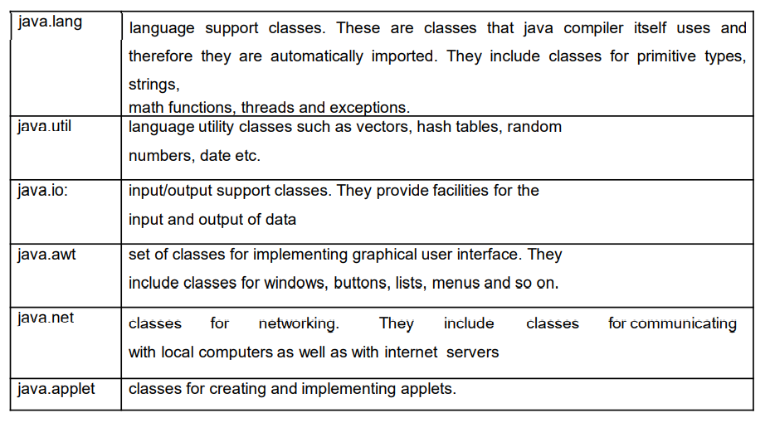
Classes stored in package can be accessed in two ways import java.awt.font; import java.awt.*;

Slide 45
Creating Package:
Declare a package at beginning of a file using
syntax: - package package_name;
Define the class that is to be put inside the package and declare it as public.
Create subdirectory under the directory where the main source files are stored.
Store the listing as classname.java files in the subdirectory created.
Compile the file, this creates .class file in the subdirectory.

Slide 46
How to access package from another package
There are three ways to access the package from outside the package.
import package.*;
import package.classname;
fully qualified name.

Slide 47
Example of package that import the packagename.*
//save by A.java
package pack;
public class A{
public void msg()
{
System.out.println("Hello");
}
}
//save by B.java
package mypack;
// import pack.*;
class B
{
public static void main(String args[]){
pack.A obj = new pack.A();
obj.msg();
}
}

